Slide 1
SA Code of Practice for the Marketing of Health Products
November 2010

Slide 2
What we will cover today...
The Case for a Marketing Code of Practice
The Marketing Code of Practice Journey
The Parts to the Code
So What?
  Examples & Scenarios
Current Challenges
Next Steps

Slide 3

The Case...
SA Code of Practice for the Marketing of Health Products

Slide 4
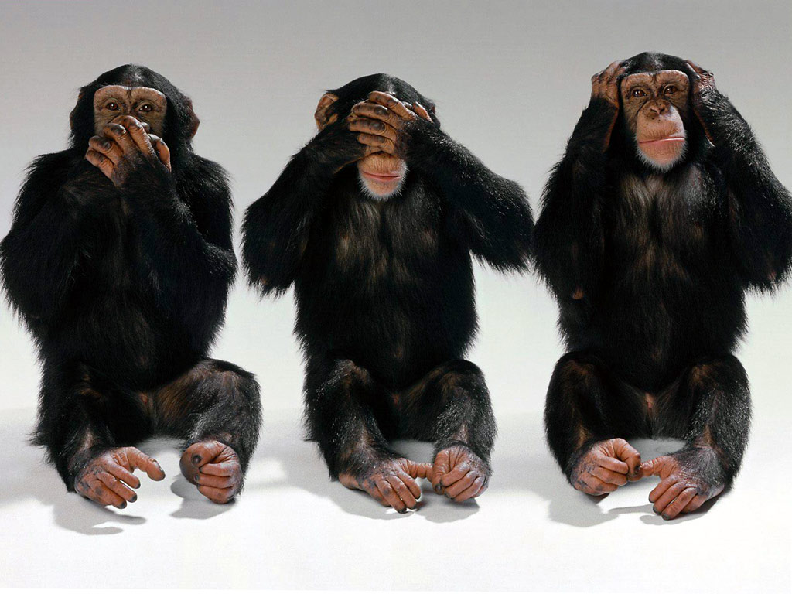

Slide 5
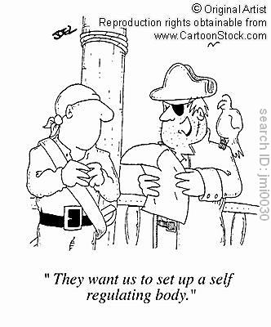

Slide 6
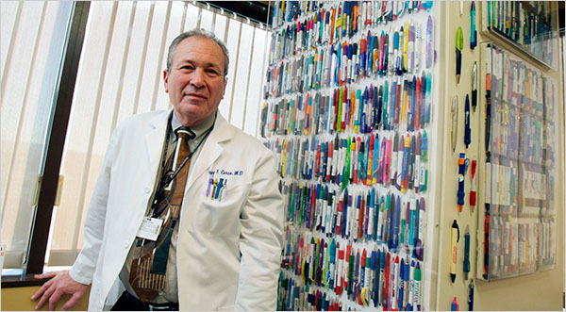

Slide 7
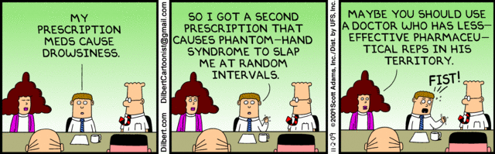

Slide 8
The Real Case...
Ethical promotion of health products
  To ensure that health care professionals and the public have access to the information they need
  That patients have access to the health products they need
  That health products are prescribed and used in a manner that provides the maximum healthcare benefit to patients
Promotional activities that comply with applicable legal, regulatory and professional requirements

Slide 9
The Real Case...
To enhance the rational use of health products and fair competition in the marketing thereof
To establish a clear understanding of the appropriate use of health products
Accurate information about health products is integral to providing quality healthcare services to patients
Preserve the independence of the decisions taken by healthcare professionals

Slide 10
The Journey...
SA Code of Practice for the Marketing of Health Products

Slide 11
A world first...
July 2007 – Marketing Steering Committee
2009 – SAMED & SALDA join
Feb 2010 – Interim Board of the MCA
Oct 2010 – Agreed version of the Code and MoU
Launch

Slide 12
Associations Involved...
INNOVATIVE MEDICINES SA (IMSA)
NATIONAL ASSOCIATION OF PHARMACEUTICAL MANUFACTURERS (NAPM)
PHARMACEUTICALS MADE IN SA (PHARMISA)
PHARMACEUTICAL INDUSTRY ASSOCIATION OF SA (PIASA)
SELF-MEDICATION MANUFACTURERS ASSOCIATION OF SA (SMASA)
THE SOUTH AFRICAN ANIMAL HEALTH ASSOCIATION (SAAHA)
SOUTH AFRICAN MEDICAL DEVICE INDUSTRY ASSOCIATION (SAMED)
SOUTHERN AFRICAN LABORATORY DIAGNOSTICS ASSOCIATION (SALDA)
PHARMACEUTICAL WHOLESALERS AND DISTRIBUTORS
PHARMACEUTICAL SOCIETY OF SOUTHERN AFRICA (PSSA)

Slide 13
The Parts...
SA Code of Practice for the Marketing of Health Products

Slide 14
The Parts to the Code...
PART A – Marketing and promotion of health products to healthcare professionals (19 clauses)
PART B – Marketing and promotion of health products directly to the consumer (18 clauses)
PART C – Medical Devices (7 clauses)
PART D – Provision for enforcement of the Code (12 clauses)
The Code is further supported by Guidelines to the Interpretation of the Code and a Sanction & Corrective Action Proposal

Slide 15
So What?
SA Code of Practice for the Marketing of Health Products

Slide 16
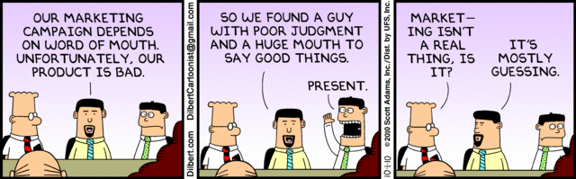
Examples / Scenarios...
PART A – Marketing and promotion of health products to healthcare professionals

Slide 17
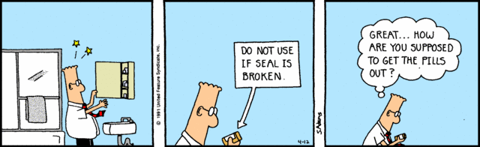
Examples / Scenarios......
PART B – Marketing and promotion of health products directly to the consumer

Slide 18

Examples / Scenarios...
PART C – Medical Devices

Slide 19

Examples / Scenarios...
PART D – Provision for enforcement of the Code
SA Marketing

Slide 20
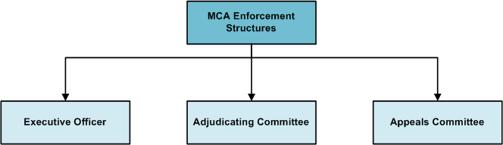
Enforcement Structures

Slide 21
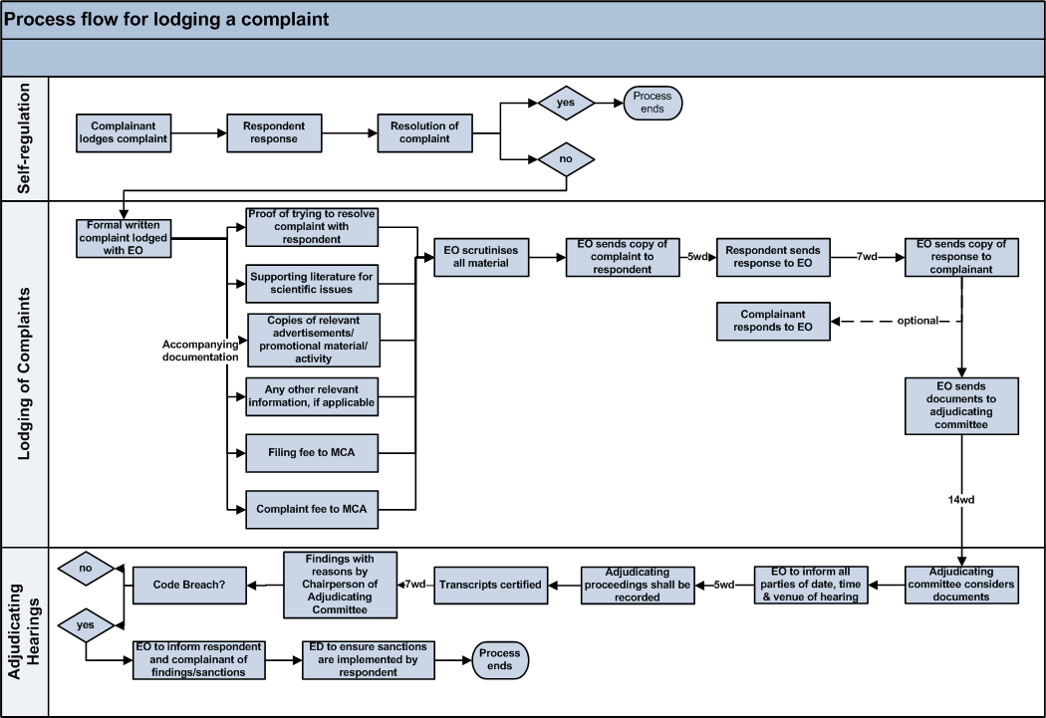
Lodging a complaint...

Slide 22
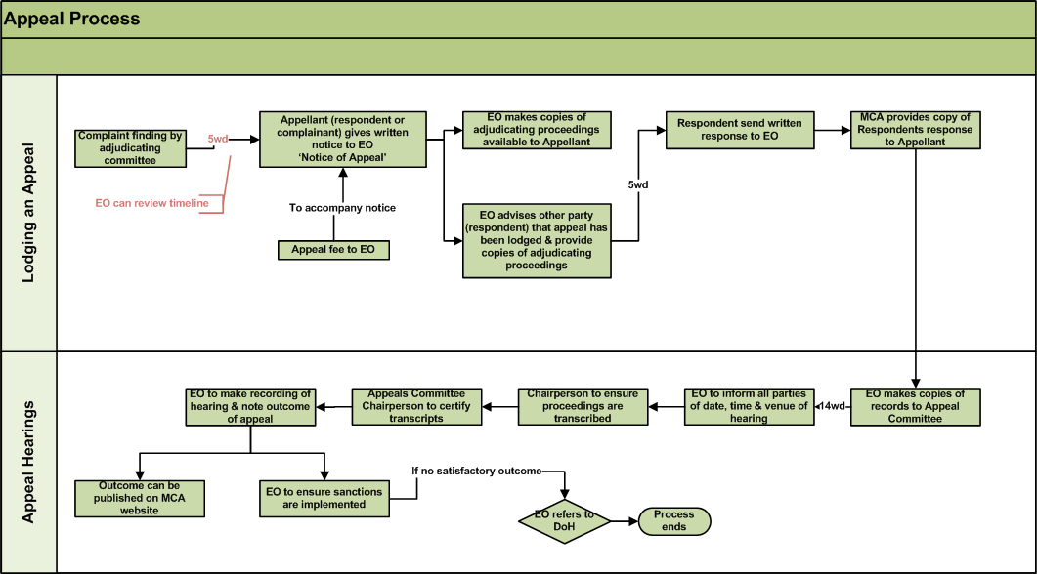
Appeal process...

Slide 23
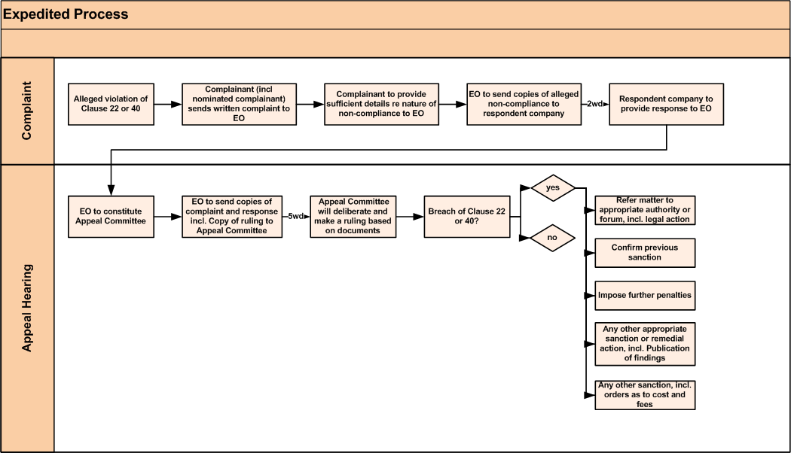
Expedited process...

Slide 24
Proposed sanctions...
Breach Classification | Expanded definition | Corrective Action/Public Disclosure | Fine | Timelines
Minor | No safety implications for patients’ well being No effect on how healthcare professionals will use product | Immediate withdrawal of material/activity from market Company to Issue a corrective statement, as determined by MCA, including target audience Written reprimand to company by MCA Notify HCP of breach, if relevant | R6K-R100K | 30 days
Moderate | No safety implications to patients’ wellbeing May have effect on how healthcare professionals will use product | Immediate withdrawal of material/activity from market Company to Issue a corrective statement, as determined by MCA, including target audience Written reprimand to company by MCA Notify HCP of breach, if relevant Publication of corrective advertisement, as determined by MCA, including target audience | R100K-R200K | 30 days
Serious/Severe | Will have safety implications to patients’ wellbeing Will have effect on how healthcare professionals will use product Commercial impact on relevant market Activities that bring disrepute to industry or reduce confidence in the industry | Immediate withdrawal of material/activity from market Written reprimand to company by MCA Publication of corrective advertisement, as determined by MCA, including target audience Issue a corrective letter to healthcare professionals/public, as determined by MCA | R200K– R300K | 30 days

Slide 25
Proposed sanctions...
Breach Classification | Expanded definition | Corrective Action/Public Disclosure | Fine | Timelines
Fines not paid | When a monetary fine is not paid within the required time period from receipt of the decisions and the reasons for the decisions of the MCA |  | Further fine of R50K | 60 days
Corrective Action not implemented | Where corrective action has not been actioned within required timelines Any other sanction including orders as to cost and fees | The matter will be raised by MCA with the subject company and may be taken to MCA for consideration | Further fine of R100K | 60 days
Repeated Breaches | >3 infringements in 1 year When a company repeats any breach, as classified by MCA, in the promotion/activity of any of the company’s products/activity | The MCA may publish the decision in a newspaper with national circulation along with the name of the offending company. Publication of the infraction on MCA website All postings will remain on website for 12 months. Inform the MCC of infringement and recommend cancellation of registration of product | First:R10K + original fine; Second: R15K + original fine; Third: R25K + original fine R200K max MCC can cancel product registration | 60 days

Slide 26
Proposed sanctions...
Breach Classification | Expanded definition | Corrective Action/Public Disclosure | Fine | Timelines
Multiple breaches | Where the MCA, through monitoring, finds a number of breaches of the Code by a company: MCA will usually consider the aggregate of the breaches to determine whether a sanction should be imposed | The MCA may publish the decision in a newspaper with national circulation along with the name of the offending company. Publication of the infraction on MCA website Inform the MCC of infringement and recommend cancellation of registration of product/s involved MCA may impose a sanction in respect of each breach of the Code, but may choose to impose an additional financial sanction | MCC can cancel product registration | 60 days
Invalid / unjustified / vexatious complaints | Does not comply with requirement of complaint as defined in Code | MCA informs complainant in writing | R10K | 60 days
Bringing the Code into disrepute | When a company brings the Code into disrepute or misrepresents the Code | The MCA may publish the decision in a newspaper with national circulation along with the name of the offending company. Publication of infraction on MCA website | R200K max | 60 days

Slide 27
Current Challenges...
SA Code of Practice for the Marketing of Health Products

Slide 28
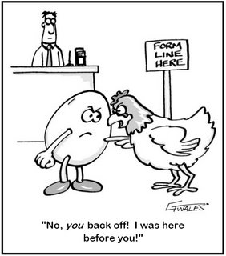
What should come first...

Slide 29
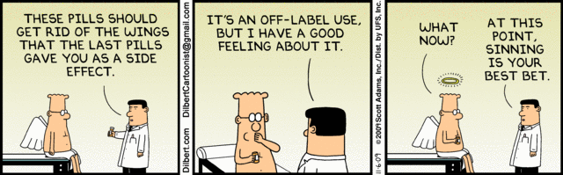
Much to unravel...

Slide 30

C...P...A...
SA Code of Practice for the Marketing of Health Products

Slide 31
Next Steps...
SA Code of Practice for the Marketing of Health Products

Slide 32
Next steps...
Finalise signatories to the Memorandum of Understanding to establish the Marketing Code Authority
Appoint an Executive Officer
Finalise Marketing Code Launch Plan
Launch the SA Code of Practice for the Marketing of Health Products
    Fully-developed training programme
    Public Relations Campaign
SA Code of Practice for the Marketing of Health Products

Slide 33
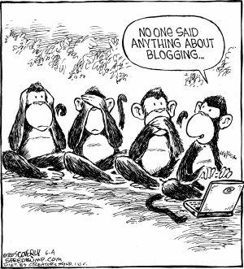
On a final note...
SA Code of Practice for the Marketing of Health Products

