Slide 1
Biosimilars Guideline – a Summary of the Industry Comments

Slide 2
Discussion Topics
BIOSIMILARS: The Scientific Aspects
BIOSIMILARS: Regulatory Update EU / US
BIOSIMILARS: Summary of Industry omments on the MCC Guideline

Slide 3
BIOSIMILARS: The Scientific Aspects
BIOSIMILARS: Regulatory Update EU / US
BIOSIMILARS: Summary of Industry Comments on the MCC Guideline

Slide 4
What is a Biosimilar?
A Biosimilar is a biological medicine that is similar, but not identical, in terms of quality, safety and efficacy to an already registered reference biological medicinal product; Synonyms: Follow-on biologics and similar biotherapeutic products (SBP)
Biotechnological products are very complex, sensitive, heterogenious mixtures of protein molecules
Each molecular entity of that mixture is characterised by specific physical, chemical and biological properties
Any change in the composition of that mixture is potentially going to affect patients safety and change to be cured
The ultimate characteristics of a medicine containing a recombinant therapeutic protein are determined by the process through which they are produced: choice of cell type, development of the genetically modified cell for production, production process, purification process, formulation of the therapeutic protein into a drug

Slide 5
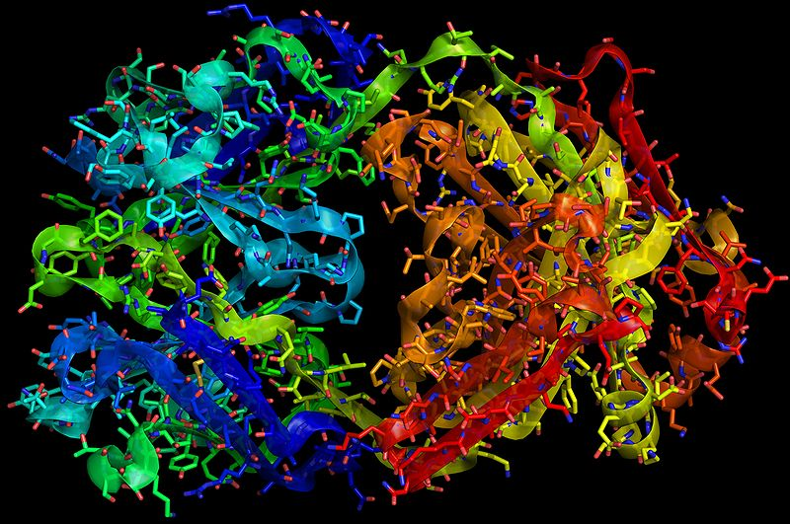
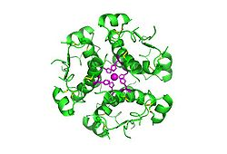
Traztuzumab (Herceptin) (± >150 000 Daltons)
Aspirin (180 Daltons)
Insulin (5700 Daltons)

Slide 6
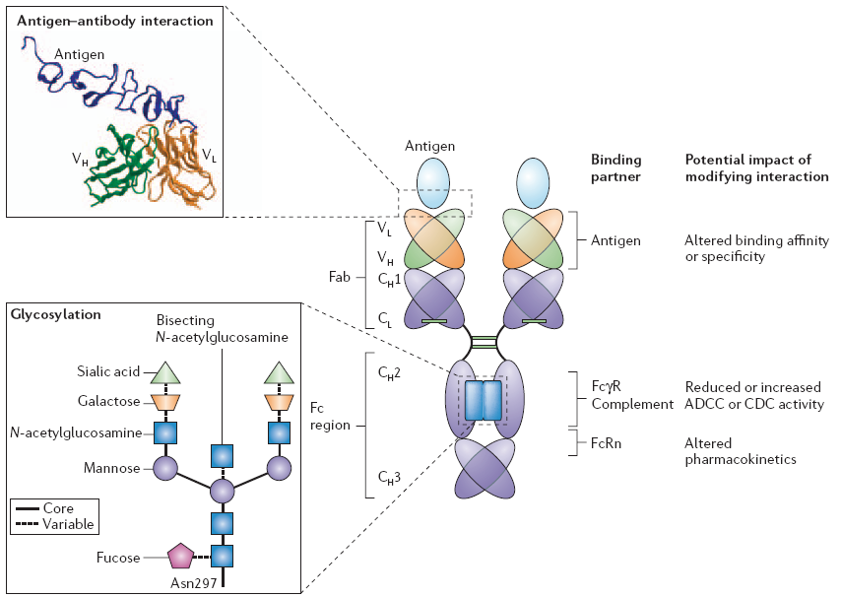
Complexity of Monoclonal Antibodies

Slide 7
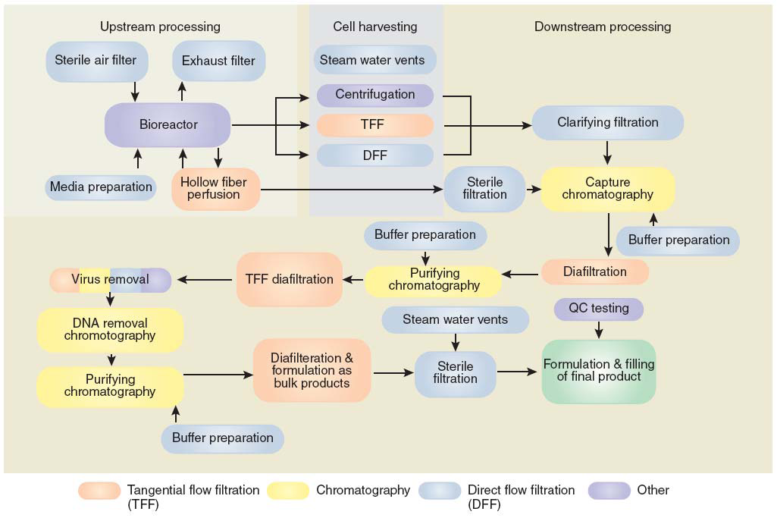
Typical Monoclonal Antibody Manufacture
The Process is the Product

Slide 8
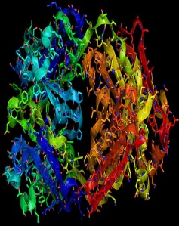
Why “Biosimilar” and not “Biogeneric”?
The Process is the Product
Fluctuations in the manufacturing process
(e.g. pH, temperature, culture media):
Batch Inconsistency
(Glycosilation spectra, aggregates)
Changes in the manufacturing process
(e.g. expression system):
New Product?
“One Process - One Product” Paradigm
Biotechnological Products are “individuals”
Biotechnological Products are more than the drug substance
Small changes can have high impact

Slide 9
BIOSIMILARS: The Scientific Aspects
BIOSIMILARS: Regulatory Update EU / US
BIOSIMILARS: Summary of Industry Comments on the MCC Guideline

Slide 10
Regulatory Update EU
Europe was the first region in the world with a comprehensive legislative and regulatory pathway for the introduction of biosimilars.
The two cornerstones of the EMEA CHMP guidelines are the need for clinical data and the comparability exercise to show biosimilarity in quality, efficacy and safety.
Six biosimilars have been approved under this pathway.

Slide 11
EU Guidelines
The EMEA's Committee for Proprietary Medicinal Products (CPMP), and its descendant, the Committee for Medicinal Products for Human Use (CHMP), have issued a number of guidance documents since 2001
The overarching document, CHMP/437, sets the scene by recognizing that the generic approach no longer suffices where biosimilars are concerned
The other documents can be categorized according to their focus on quality or clinical issues, or their focus on changes to an existing manufacturing process or an entirely new process.
An important distinction to be made in this regard is between ‘comparability’, which assesses products preceding and following a change in manufacturing process, and ‘similarity’, which assesses products from entirely different manufacturing processes, with a focus on safety and efficacy.
The guidelines pertaining to changes in a manufacturing process have already been approved, although the document on quality issues will be superseded by the QE5 document from the ICH (International Conference on Harmonisation).
The ICH seeks to harmonize regulatory processes across the US, Europe and Japan. EMEA guidelines relevant to new manufacturing processes for biosimilars are still under review. They are supplemented by a number of Concept Papers, which provide the basis for a case-by-case approach.

Slide 12
Regulatory Update - US
Legislation was approved in March to create a regulatory pathway for the approval of biosimilars or follow-on medicines
The FDA has yet to issue rules on the new law, which would give the “innovator companies” — those who produce the name-brand biologics — 12 years of data exclusivity before their drug patents can face competition
Momenta Pharmaceuticals Inc. in Cambridge gained approval for its generic version of the anticoagulant Lovenox, made by French pharmaceutical company Sanofi-aventis. Momenta did not gain approval based on the new law but through an alternative regulatory pathway, in place for years

Slide 13
BIOSIMILARS: The Scientific Aspects
BIOSIMILARS: Regulatory Update EU
BIOSIMILARS: Summary of Industry Comments on the MCC Guideline

Slide 14
General Comments
This guideline includes the key components of what is considered to be a minimum necessary approach to approving biosimilars and even goes beyond this in some ways
The guideline makes the point clearly that biosimilars are not generic drugs and that guidelines and regulatory practices associated with generic drugs are not applicable to biosimilars
One question to be grappled with (also an open question in the U.S. at the moment) is what is "highly similar?" This is not a defined term in the guideline (as it is not in the recently enacted U.S. legislation) and it will be interesting to see, as matters progress, how this will be "defined" in practice
This guideline is confined to "well-characterized" biologics and is not as broad as other approaches (including the U.S.) that currently appear applicable to all biological products. This guideline specifically, interestingly, excludes monoclonal antibodies, which seems to signal the country's intent to follow Europe, with a separate guideline or set of guidelines for these unique products. This is an important issue that needs further clarification.

Slide 15
General Comments
The guideline states strongly that clinical studies, which need to be comparability studies, will be required for approval of biosimilars
This was an important argument in the U.S., as the generic industry pushed for language in statute that specifically discouraged any requirement for clinical studies, while the innovator industry argued that they would be essential
In addition, the guideline specifically states that a "CMC" component will be a necessary part of the biosimilars application, to ensure ongoing safety, consistency, etc. with the application of good manufacturing practices
It is not surprising that the guideline does not deal with naming, as it states early on that it is informed by the EMEA and WHO guidelines, neither of which deals with naming in this sort of guideline. Indeed, naming remains unsettled in Europe and unclear in the U.S. Since this guideline is intended to deal with application content in terms of ensuring safety and efficacy of products, it also is not the right vehicle for discussion of exclusivity, which would be dealt with (if at all) in another way

Slide 16
Current text / reference to paragraph | Proposed Amendment | Rationale / Remarks
Guideline Heading: GUIDELINES FOR SIMILAR BIOLOGICALMEDICINES (BIOSIMILAR MEDICINES) NON-CLINICAL AND CLINICAL REQUIREMENTS | GUIDELINES FOR SIMILAR BIOLOGICAL MEDICINES (BIOSIMILAR MEDICINES) QUALITY, NON-CLINICAL AND CLINICAL REQUIREMENTS. | We recommend inclusion of the word “Quality” in the heading, as Quality aspects are addressed in the guideline. Clarity is requested in terms of what other guidelines for similar biological medicines are anticipated.
1. Preamble These guidelines are currently limited to therapeutic protein medicines produced using recombinant DNA technology and other similar technologies. | These guidelines are currently limited to therapeutic protein medicines produced using recombinant DNA technology and other similar technologies. | Clarity is needed on the statement “and other similar technologies”

Slide 17
Current text / reference to paragraph | Proposed Amendment | Rationale / Remarks
2. Scope Vaccines and plasma-derived products, recombinant blood-factors and, Monoclonal antibody products are excluded from the scope of this document. | Vaccines and plasma-derived products, recombinant blood-factors and, Monoclonal antibody products are excluded from the scope of this document. | Does it mean that abbreviated applications are not available for these products and that a full new application would need to be submitted? It seems to signal that the MCC’s intent is to follow Europe with a separate guideline (or set of guidelines) for these unique products.
This guideline also does not address the comparability exercise for changes introduced in the manufacturing process of a given product, that is, changes during development and post-registration. These issues are covered in the current Post-Registration Amendments Guidelines. | This guideline also does not address the comparability exercise for changes introduced in the manufacturing process of a given product, that is, changes during development and post-registration. These issues are covered in the current Post-Registration Amendments Guidelines. | The applicant should demonstrate that the amendments to the method of synthesis of the API do not affect the biological properties of the product and that its efficacy and safety is equivalent to the product synthesised by the registered method. Process changes must be justified by comparability testing, guided by physicochemical and in-vitro biological assays. Comparability in terms of physicochemical properties of CMC (quality) information on the biosimilarity with the reference product approved in .

Slide 18
Current text / reference to paragraph | Proposed Amendment | Rationale / Remarks
3. Introduction and General Guidance The guideline outlines the non-clinical and clinical requirements for biosimilar medicines. The non-clinical section addresses the physico-chemical and quality requirements. The clinical section addresses the requirements for pharmacokinetic, pharmacodynamic, safety and efficacy studies as well as the pharmacotoxicological assessments, with special emphasis on studying the immunogenicity of the biosimilar medicines. The section on pharmacovigilance addresses the in-use safety of the medicine as well as the risk management plan. | The proposal below provides for “quality” to be incorporated into this statement. The guideline outlines the quality, non-clinical and clinical requirements for biosimilar medicines. The quality section addresses the physico-chemical and quality requirements. The non-clinical section addresses the pharmaco-toxicological assessments. The clinical section addresses the requirements for pharmacokinetic, pharmacodynamic, safety and efficacy studies with special emphasis on studying the immunogenicity of the biosimilar medicines. The section on pharmacovigilance addresses the in-use safety of the medicine as well as the risk management plan. | We recommend separation of quality aspects and non-clinical aspects: The non-clinical section is not aimed per se to address physico-chemical and quality issues, but is rather dedicated for pharmaco-toxicological assessment. In the same way, the clinical section does not address per se pharmaco-toxicological assessments.
The quality issues relevant for demonstration of comparability for similar biological medicinal products containing recombinant DNA-derived proteins have been addressed in the EMEA ”Guideline on similar biological medicinal products containing biotechnology-derived proteins as active substances: quality issues”. Product class specific annexes will supplement this guideline where a need has been or will be identified. In any case, the company should justify the approach taken during the development of the product. | The quality issues relevant for demonstration of comparability for similar biological medicinal products containing recombinant DNA-derived proteins have been addressed in the EMEA ”Guideline on similar biological medicinal products containing biotechnology-derived proteins as active substances: quality issues”. Product class specific annexes will supplement this guideline where a need has been or will be identified. In any case, the company should justify the approach taken during the development of the product. | We recommend deletion of the first paragraph, as indicated. Clarity is needed on the intention of the MCC to establish a similar guideline system on biosimilars, similar to the EMEA.

Slide 19
Current text / reference to paragraph | Proposed Amendment | Rationale / Remarks
5. Clinical, Safety and Efficacy 5.1 Non-Clinical data Non-clinical studies should be performed before initiating clinical development, and should be comparative in nature, designed to detect differences in response between the similar biological product and the reference medicinal product and not just the response per se. The objective is to establish the chemical and molecular nature of the active ingredient, and to show that it has no detectable differences in physico-chemical characteristics when compared to the active ingredient in the innovator product must be fully justified in the non-clinical overview and/or the pharmaceutical expert report. | 5. Quality / Non-Clinical Data / Clinical, Safety and Efficacy 5.1 Quality Data The objective is to establish the chemical and molecular nature of the active ingredient, and to show that it has no detectable relevant differences in physico-chemical characteristics when compared to the active ingredient in the innovator product. Add in the following: The final biosimilar product must also be compared to the reference product. The quality issues relevant for demonstration of comparability for similar biological medicinal products containing recombinant DNA-derived proteins have been addressed in the EMEA ”Guideline on similar biological medicinal products containing biotechnology-derived proteins as active substances: quality issues”. | We suggest separate headings for quality aspects and non-clinical aspects, as indicated. We suggest that the word “detectable” should be changed to “relevant”, as some detectable physico-chemical differences may not be relevant, in that they would not adversely affect the quality or activity of the product. It should be clearly specified that comparison should not only be done on the active ingredient but also on the finished product; (formulation, packaging may also have a strong impact on the quality and stability of the product and ultimately on its efficacy and safety).

Slide 20
Current text / reference to paragraph | Proposed Amendment | Rationale / Remarks
5.1 (Cont.) Analytical techniques that can show the comparable functionality of the biosimilar and the innovator product in appropriate in-vivo and in-vitro systems should be used. The functions for analysis that are selected should be shown to relate to the clinical activity of the molecule. | Sensitive and qualified analytical techniques that can show the comparable functionality of the biosimilar and the innovator product in appropriate in-vivo and in-vitro systems should be used. The functions for analysis that are selected should be shown to relate to the clinical activity of the molecule. | We recommend insertion of the words “Sensitive and qualified”: All assays to be used in comparative assessments should be qualified in the sense that it is known what structural differences they can detect. In case there are different assays available, the most sensitive should be used.
In-vivo animal studies to show comparable toxicology and activity should be presented. | In-vivo animal studies to show comparable toxicology and activity should be presented. | In the EU, there is discussion on whether toxicology studies need to be comparative, especially when primates are required. If the safety profile of the reference product is well established, it may not be necessary or appropriate to test the reference product again.
The guidance documents such as EMEA "Note for guidance on Non-clinical safety evaluation of biotechnology derived pharmaceuticals" (CPMP/ICH/302/95) should be taken into consideration. Ongoing consideration should be given to the use of emerging technologies. (For example: In vitro techniques such as e.g. ‘real-time’ binding assays may prove useful. In vivo, the developing genomic/proteomic micro-array sciences may, in the future, present opportunities to detect minor changes in biological response to pharmacologically active substances). | The guidance documents such as EMEA "Note for guidance on Non-clinical safety evaluation of biotechnology derived pharmaceuticals" (CPMP/ICH/302/95) should be taken into consideration. Ongoing consideration should be given to the use of emerging technologies. (For example: In vitro techniques such as e.g. ‘real-time’ binding assays may prove useful. In vivo, the developing genomic/proteomic micro-array sciences emerging technologies may, if appropriately validated, in the future, present opportunities to detect minor changes assess comparability in biological response to pharmacologically active substances). | We recommend that the wording be changed as indicated. With reference to “emerging” or state of the art technologies: It is recommended that these technologies should be appropriately validated in order to be relied upon for the intended use. It is also recommended to be more general in reference to new technologies and to not specifically cite genomic/proteomic micro-arrays.

Slide 21
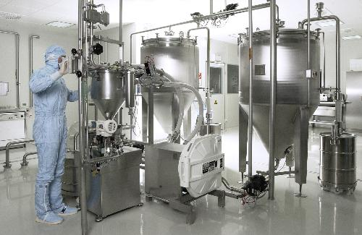
Current text / reference to paragraph | Proposed Amendment | Rationale / Remarks
5.1 (Cont.) The approach taken to establish the chemical and molecular nature of the active ingredient, and to show that it has no detectable differences in physico-chemical characteristics when compared to the active ingredient in the innovator product must be fully justified in the non-clinical overview and/or the pharmaceutical expert report. | The approach taken…[…]… expert report. Comparison against pharmacopoeial monographs is not sufficient to establish similarity with the active ingredient in the innovator product. | We recommend addition of a sentence as indicated. Considering the complexity of biological products, it must be clarified that compliance with a pharmacopoeial monograph, although necessary, is not sufficient for establishing biosimilarity. A proper comparison done against the reference product which is known to be safe and effective can provide the assurance of safety and efficacy. This depends on the complexity of the products and the closeness of the comparability. Clinical and non-clinical data is however always needed.

Slide 22
Current text / reference to paragraph | Proposed Amendment | Rationale / Remarks
(before) 5.1.2 In vitro studies | Suggest to add “NON-CLINICAL DATA” at the end of section 5.1.1, before 5.1.2, as follows: Non-clinical studies should be performed before initiating clinical development, and should be comparative in nature, designed to detect differences in response between the similar biological product and the reference medicinal product and not just the response per se. Bioassays that can show the comparable functionality of the biosimilar and the innovator product in appropriate in-vivo and in-vitro systems should be used. The biological endpoints that are selected should be shown to relate to the clinical activity of the molecule. In-vivo animal studies to show comparable toxicology and activity should be presented. It is important to note that design of an appropriate non-clinical study program requires a clear understanding of the product characteristics. Results from the physicochemical and biological characterisation studies should be reviewed to assess the potential impact on efficacy and safety. The guidance documents such as EMEA "Note for guidance on Non-clinical safety evaluation of biotechnology derived pharmaceuticals" (CPMP/ICH/302/95), should be taken into consideration. | We recommend reformatting of the guideline to separate Quality Aspects from Non-Clinical Aspects. Upon completion of comparative characterisation studies with the biosimilar and reference product to demonstrate molecular similarity, then the Non-Clinical study can be designed according to EMEA/CHMP/ 42832 or other guideline, as applicable.

Slide 23
Current text / reference to paragraph | Proposed Amendment | Rationale / Remarks
5.1.3 In vivo studies Animal studies should be designed to maximise the information obtained and to compare reference and similar biological medicinal products intended to be used in the clinical trials. Such studies should be performed in a species known to be relevant and employ state of the art technology. | Animal studies should be designed to maximise the information obtained and to compare reference and similar biological medicinal products intended to be used in the clinical trials. Such studies They should be designed to detect differences in response between the similar biological product and not just the response per se. Such studies should be performed in a species known to be relevant and employ appropriately validated state of the art technology. | We recommend amendment of the text, as indicated, as it should be clearly specified that non-clinical studies should be designed to detect a difference with the reference product, should there be one. Tests should be validated.
b) Non-clinical toxicity as determined in at least one repeat dose toxicity study, including toxicokinetic measurements. Toxicokinetic measurements should include determination of antibody titres, cross reactivity and neutralising capacity. | b) Non-clinical toxicity as determined in at least one repeat dose toxicity study, including toxicokinetic measurements. Toxicokinetic measurements should include determination of antibody titres, cross reactivity and neutralising capacity. Where warranted due to drug homology to endogenous proteins, anti-drug antibody cross reactivity to endogenous proteins may be needed. Depending upon TK assay format and PD markers, the characterization of anti-drug antibodies as to neutralizing may be needed to interpret the study. | WHO Guideline states: Although the predictive value of animal models for immunogenicity in humans is considered low, antibody measurements, if applicable, should be included in the repeat dose toxicity study to aid in the interpretation of the toxicokinetic data and to help assess, as part of the overall comparability exercise, whether important differences in structure or immunogenic impurities exist between the similar biological product and the reference product.

Slide 24
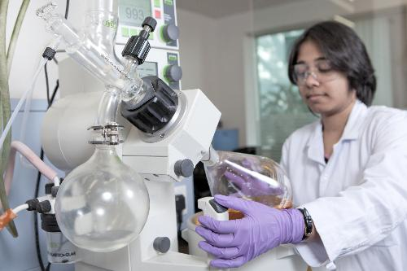
Current text / reference to paragraph | Proposed Amendment | Rationale / Remarks
5.1.3 In vivo Studies 5.1.3 (b) If there are specific safety concerns, these might be addressed by including relevant observations (i.e. local tolerance) in the same repeat dose toxicity study. | If there are specific safety concerns, these might be addressed by including relevant observations (i.e. local tolerance) in the same repeat dose toxicity study. | It is recommended that this part of 5.1.3 be removed, to avoid the possibility of misunderstanding.
Animal immunogenicity studies may be of value in demonstrating similarity of immune responses to reference and biosimilar products. | Animal immunogenicity studies may be of value in investigating similarity of immune responses to reference and biosimilar products, but cannot be an alternate to studies in humans. Animal models are usually not predictive of the immune response in humans.

Slide 25
Current text / reference to paragraph | Proposed Amendment | Rationale / Remarks
Clinical Data 5.2.2 The selected dose should be in the steep part of the dose-response curve. Studies at more than one dose level may be useful | The selected dose should be in the steep part of the dose-response curve. Studies at more than one dose level may be useful. Where a reference product is used at a range of doses, doses across the steep part of the dose response curve should be emphasized. Where only one or a few doses of the reference product are approved, PD measures should be limited to these dose(s). | It is not normally useful to show a dose-response for a biosimilar product if the reference product is only approved at one dose. We therefore recommend amendment of the text, as indicated.
5.2.3 Normally comparative clinical trials are required for the demonstration of clinical comparability. In certain cases, however comparative PK/PD studies between the similar biological medicinal product and the reference medicinal product may be sufficient to demonstrate clinical comparability, provided that all the following conditions are met: | Normally comparative clinical trials are required for the demonstration of clinical comparability. In certain cases, however comparative PK/PD studies between the similar biological medicinal product and the reference medicinal product may be sufficient to demonstrate clinical comparability, similar efficacy provided that all the following conditions are met: | PK/PD studies, in some cases where there are validated surrogate markers, may be used for establishing similar efficacy but they are not sufficient for establishing similar safety.

Slide 26
Current text / reference to paragraph | Proposed Amendment | Rationale / Remarks
5.2.4 Comparative clinical trials will usually be necessary to demonstrate clinical comparability between the similar biological and the reference medicinal product. Clinical comparability margins should be pre-specified and justified, primarily on clinical grounds. As for all clinical comparability trial designs, assay sensitivity (see ICH topic E10) has to be ensured. | Comparative clinical trials will usually be necessary to demonstrate clinical comparability between the similar biological and the reference medicinal product. With respect to the design these should be adequately powered, randomized, double-blind and controlled clinical trial(s) conducted in the relevant patient population. Clinical comparability margins should be pre-specified and justified, primarily on clinical grounds. As for all clinical comparability trial designs, assay sensitivity (see ICH topic E10) has to be ensured. | We recommend that the basic requirements on the design of the comparative clinical trials should be specified.
If a clinical comparability trial design is not feasible, other designs should be explored and their use discussed with the competent authorities | If a clinical comparability trial design is not feasible, other designs should be explored and their use discussed with the competent authorities. If the reference product has more than one indication, clinical trials for each indication should be performed, unless a scientific basis for extrapolating safety and efficacy between indication is supported. | In this section it should also be mentioned that if the reference product has more than one indication, similar efficacy and safety should be justified for each indication. This is to address different responses with different disease states, unless a scientific justification can be made from one indication to another.

Slide 27
Current text / reference to paragraph | Proposed Amendment | Rationale / Remarks
5.2.6.3 The immunogenicity of a similar biological medicinal product must always be investigated. Normally an antibody response in humans cannot be predicted from animal studies. The assessment of immunogenicity requires an optimal antibody testing strategy, characterisation of the observed immune response, as well as evaluation of the correlation between antibodies and pharmacokinetics or pharmacodynamics, relevant for clinical safety and efficacy in all aspects. | The immunogenicity of a similar biological medicinal product must always be investigated in human. Normally an antibody response in humans cannot be predicted from animal studies. Even in cases where a similar efficacy is established in confirmatory PK/PD studies, immunogenicity must be investigated in the target patient population. The assessment of immunogenicity requires an optimal antibody testing strategy, characterisation of the observed immune response, as well as evaluation of the correlation between antibodies and pharmacokinetics or pharmacodynamics, relevant for clinical safety and efficacy in all aspects. | We recommend that, in order to avoid any confusion, it must be specified (as indicated) that even in cases where a similar efficacy can be established through PK studies (in healthy volunteers); immunogenicity comparison with the reference product must always be investigated in the target patient population due to the differential susceptibility between healthy volunteers and patients.
5.2.6.4 The applicant should present a rationale for the proposed antibody-testing strategy. Testing for immunogenicity should be performed by state of the art methods using assays with appropriate specificity and sensitivity. The screening assays should be validated and sensitive enough to detect low titre and low affinity antibodies. …[…]… | The applicant should present a rationale for the proposed antibody-testing strategy. Testing for immunogenicity should be performed by state of the art methods using assays with appropriate specificity and sensitivity. The screening assays should be validated and sensitive enough to detect low titre and low affinity antibodies and should be used at low dilutions of test samples (e.g. <1:100 dilution) so that low levels of antibody can be detected. …[…]… | We request more clarity in terms of the term “low titre”, and suggest the inclusion of additional text, as indicated. With specific reference to the following phrase: “Testing for immunogenicity should be performed by state of the art methods using assays with appropriate specificity and sensitivity.” – We request guidance on the expectations in terms of comparing the innovator immune response to the historical data. Rationale: It should be acknowledged that the method used for immunogenicity testing of the biosimilar may likely differ from the method used by the innovator. Therefore the results may differ from historical results.

Slide 28
Current text / reference to paragraph | Proposed Amendment | Rationale / Remarks
6 Glossary of Terms Biological Medicines include, but may not be limited to the following: Plasma-derived products, e.g. Clotting factors, Immunosera, etc; Vaccines; Biotechnology-derived medicinal products (rDNA products) e.g. rHu-antihaemophilic factors, hormones, cytokines, enzymes, monoclonal antibodies, erythropoietins Products developed for Human Gene therapy |  | In this section, monoclonal antibodies are included under “Biotechnology-derived medicinal products”. We thus require clarification on whether monoclonal antibodies are included under this guidance.

Slide 29
Everything we do matters to somebody. Thank you.

