Slide 1

Update on Regulatory Developments around the eCTD in Europe and the Quantum Leap ahead for South Africa
SAPRAA
16 November 2012
Henriette Vienings

Slide 2
Agenda
Introduction
Developments in 2012
Paperless Regulatory Authorities
Software Vendors
Submission Ready Documents

Slide 3
Introduction
Acknowledgements:
  Knowledge shared today is knowledge gained at Lorenz' User Conference in Ireland in September 2012 and through the work we do at MRA Regulatory Consultants (MRA) on a daily basis.
  Thank you SAPRAA for the opportunity to present here today.
MRA is a docuBridge user and snapshots of builder images are taken from our compilation environment.

Slide 4
Developments in 2012
In fact – not just in Europe… - ICH driven activity = Global
  USA
  Canada
  Other regions
eCTD 4 / eCTD NMV – ICH M8, Endorsed 11 Nov. 2010
  eCTD 4 = The next major version (NMV) of the eCTD
  The challenge: to continue supporting the current ICH eCTD v3.2.2 and STF v2.6.1 requirements
  Implementation Plan for eCTD4 – in 4 Steps
    Currently in Step 2 – Testing of the ICH eCTD v4.0 DRAFT Implementation Guide v1.0 as of June 2012 – March 2013.
  Subgroup to M2 Expert Working Group (EWG) responsible for the eCTD Specifications
http://www.ich.org/

Slide 5
eCTD 4 / eCTD NMV &
Regulated Product Submission (RPS)
Setting the scene for document reusability, interoperability between builders and shared review (- the brave new world…)
  Universally Unique Identifiers (UUI)
      for sequences in each application
      for each individual file
      for communication between Agency and Applicant – portal environment
  Controlled Vocabulary (CV) – harmonising terminology
      Drug Substance, Active Substance, Active Ingredient
      Drug Product, Finished Product
http://www.ich.org/

Slide 6
eCTD 4 / eCTD NMV &
Regulated Product Submission (RPS)
Functional improvements
      Sequence Replication – content reusability
      Regulatory Activity – grouping sequences that apply to one activity
      Access to the entire application from any part of the application
      Capability to identify which eCTD sequence was used at which step of agency review
      Cross-referencing files across different sequences in one product’s lifecycle and, or across different products
      Compatibility across regions and across the regional lifecycling methodology / philosophy
http://www.ich.org/

Slide 7
eCTD 4 / eCTD NMV &
Regulated Product Submission (RPS)
Maintaining similarity to the current eCTD file-leaf model in the eCTD NMV with the following exceptions:
    Lifecycle changes to existing documents will allow only:
      New
      Replace
      Delete
      Appending documents will no longer be possible.
    Supporting changes in granularity.
http://www.ich.org/

Slide 8
eCTD 4 / eCTD NMV &
Regulated Product Submission (RPS)
  Validation improvements:
    ensure that the document specification (DTD) remains unchanged – MD5 checksums
    Should ensure that all files submitted are defined and referenced
    Support the use of controlled vocabularies for both harmonised metadata and regional metadata
    Specify date values in an unambiguous manner
    Integrity of electronic files within an instance
    Will not negate previous versions of the eCTD. These should remain valid submissions and reviewing tools should be able to review submissions made in terms of eCTD 3.2x specifications even if they are enabled for eCTD NMV.

Slide 9
eCTD 4 / eCTD NMV &
Regulated Product Submission (RPS)
Data transfer
  Applicant ➔ Regulatory Authority / Regulatory Authority ➔ Applicant
    No restriction on mechanism for transmitting - media type/network
    Supporting 2-way communication
    Enabling acknowledgement of receipt
    Traceability and relationship between activities and sequence submission

Slide 10
ETICS III
eCTD Tools Interoperability and Compliance Study
  ICH study of eCTD tools to look at the issues of:
    Interoperability:
      Can an eCTD created by one tool be opened and used by another?
    Compliance:
      Is the eCTD compliant with ICH and regional requirements?
  11 Tools were tested
Bryan Ennis – userBridge 2012

Slide 11
ETICS III
Launched February 2010 as a project of the IRISS Interoperability Group
      IRISS = Implementation of Regulatory Information Submission Standards
Questions/departure points for ETICS III:
  How are systems, that are capable of meeting regulatory requirements, enable collaboration and establish traceability of content, enabled?
Bryan Ennis – userBridge 2012

Slide 12
ETICS III
Current IT technology advances such as Cloud-based systems and mobile devices, are emerging to enable globally-distributed staff to acquire, create, and manage regulated content that is universally accessible, reportable, and is extensible.
ETICS III is qualifying the interoperability and validation capabilities of current regulatory submission technologies – the CTD builders (as we know them).
Bryan Ennis – userBridge 2012

Slide 13
Further Developments in Europe - 2012
XEVPRM / XEVMPD
Late in 2010, EC Directives were implemented in an effort to improve the safeguards to public health.
The regulations mandated that the EU Agencies have and maintain databases for medicinal products that:
  Provide access to the approved package leaflets in language that is considered to be understandable to the reader.
  Access must be granted to:
    all Member States
    the general public
    health-care professionals
    marketing authorisation holders (MAH)
Karl-Heinz Loebel – userBridge 2012

Slide 14
Further Developments in 2012
XEVPRM / XEVMPD
2 July 2012 was the deadline for MAHs to electronically submit the required information to the Agencies
The technical specifications of which were published in March 2012 by the EMA – all 401 pages of it…
2 Technical Environments:
  EudraVigilance Production Environment
  EudraVigilance External Compliance Testing (XCOMP) Environment
Karl-Heinz Loebel – userBridge 2012

Slide 15
Further Developments in 2012
XEVPRM / XEVMPD
The database generated enables:
  traceability of any of the following - in the event of a technical concern, counterfeit alert, adverse reaction / pharmacovigilance issue:
    Active Substances
    Excipients
    Manufacturers
    Marketing Authorisation Holders
  corrective and preventive action to be taken by an Agency where for example; suspect quality of an active substance can be traced to all products that could potentially be affected - throughout the European Region.
Karl-Heinz Loebel – userBridge 2012

Slide 16
Further Developments in 2012
AMNOG
Nutzendossier (Value Dossier) – Germany
  Requires the submission of pharmaco-economic studies and data as motivation for the need for the product in the market place
  To be submitted at the time of submitting an application for registration
  Currently not a requirement for submissions made into the EMA – Centralised Procedure for Mutual Recognition

Slide 17
Further Developments in 2012
END OF THE PAPER ERA IN EUROPE …?
By 2013 the German Regulatory Authorities will no longer accept paper submissions.
What will this mean for the EMA for whom the German Authority is a vitally important Rapporteur and technical resource.
EDQM has been paperless since 2010.
The NEES seems finally to have been abandoned.

Slide 18
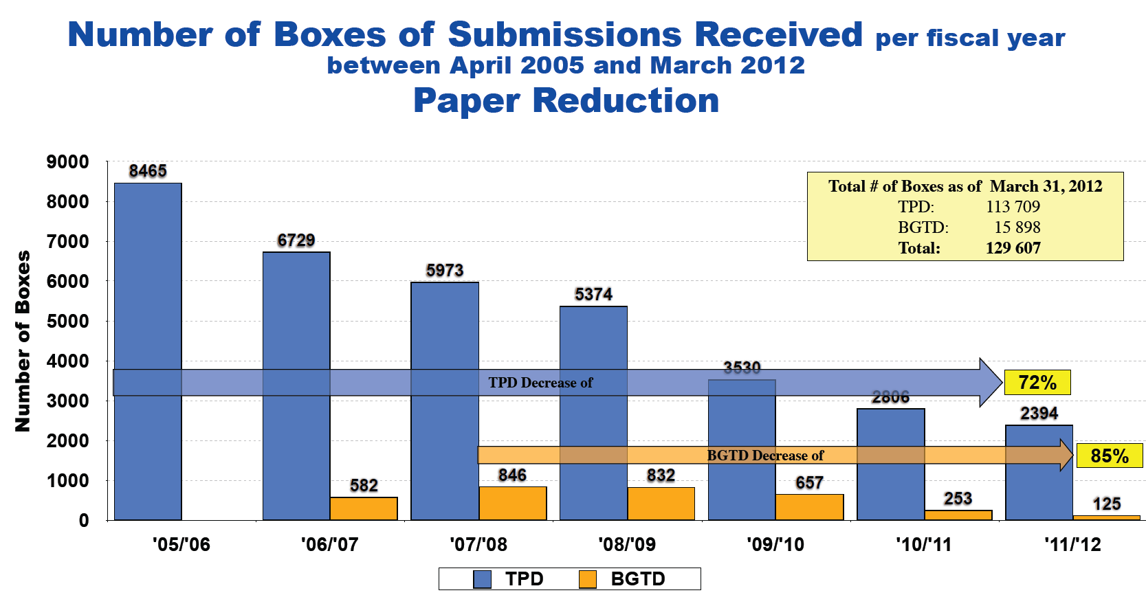
The eCTD in CANADA
TPD = Therapeutic Products Directorate
BGTD = Biologics & Genetic Therapies Directorate
Vianney Caron – Health Canada @ userBridge 2012

Slide 19
Software Vendors
CTD builders are critical in alleviating the admin burden involved in compiling submissions. They reduce mistakes and allow us to reuse our data.
Manage to integrate the ever-changing submission requirements globally into their tools.
Keep up to date with the regional specifications and provide the validation tools.
Provide databases that are customised to the regulatory environment and help us manage the information that we are the custodians of.
Provide valuable training from a “futuristic” perspective which helps us to think and plan ahead.

Slide 20
Submission Ready Documents
Think of the future - Think eCTD!
Granulate and name in accordance with ICH requirements and the regional requirements.
Ensure that you will not need to rework documents unnecessarily in the future.
It may take a little bit more time to do this, but you can train administrative assistants to help with this work.

Slide 21
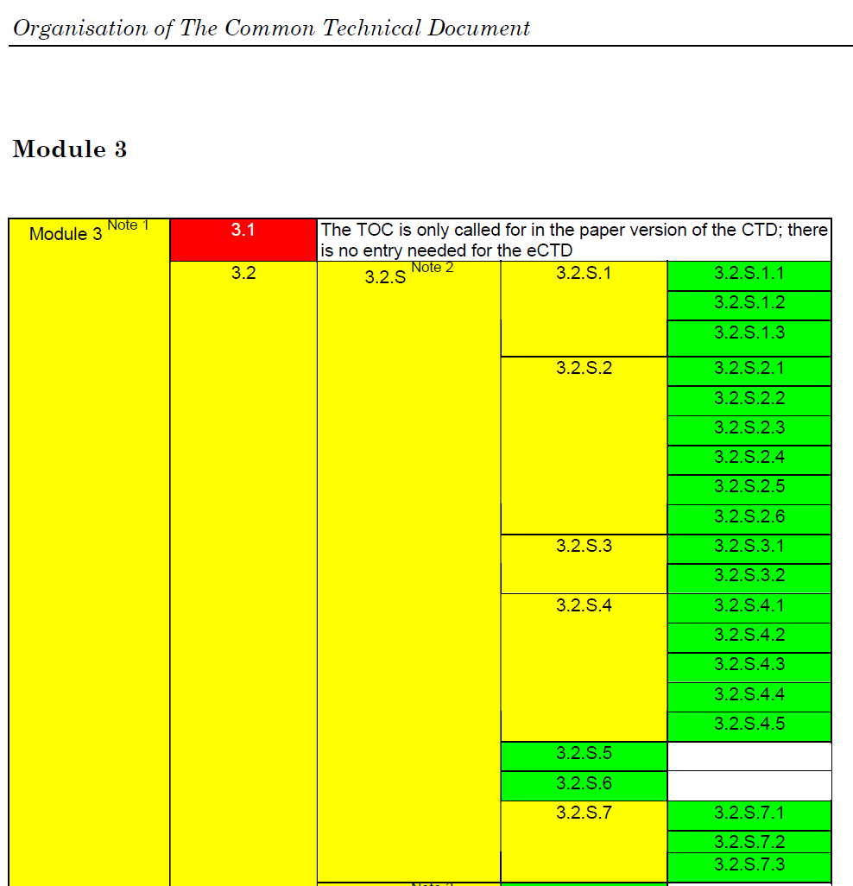
Submission Ready Documents -
Granulate and name in accordance with ICH requirements:

Slide 22
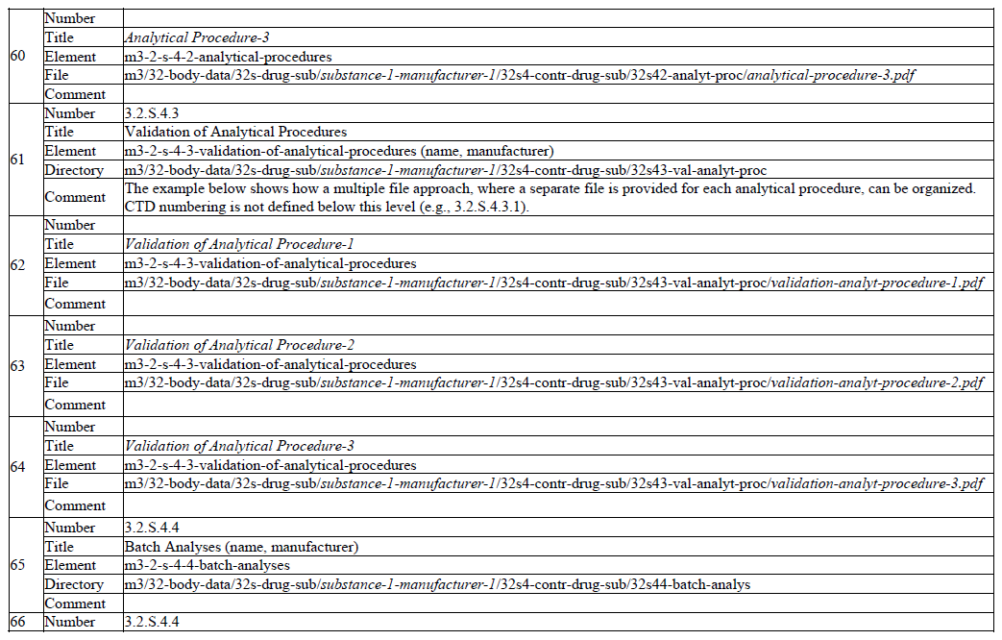
ICH M2 EWG 2008, Appendix 4: File Organisation of the eCTD

Slide 23
Submission Ready Documents - ICH
PDF:
  Version 1.4 – Agencies don’t need additional software to view documents
  Should be rendered not images/scans
  Optical Character Recognition (OCR) enabled
  Not secured / password protected
    one should be able to select, copy and paste sections out of a document into another document if needed.
    Secured/protected documents fail validation!
  Minimum resolution – text 300 dpi (dots per inch); photos 600 dpi
  Do not shrink documents/reduce size at the cost of legibility or quality.
  Compress for storage or transfer purposes if needed.
ICH M2 EWG – eCTD Specifications, 16 July 2008

Slide 24
Submission Ready Documents - ICH
Fonts:
  Ensure that only standard fonts are used
  Embed fonts
  Text size – minimum size equivalent to Times New Roman 12
  Table text size – minimum size equivalent to Times New Roman 10
Company logos are not to be inserted into headers/footers. - Even if the logo is only 5b in size, imagine that multiplied across a 50 000 page submission.
Company logos are acceptable on letterheads and signed reports.
ICH M2 EWG – eCTD Specifications, 16 July 2008

Slide 25

The Quantum Leap…

Slide 26

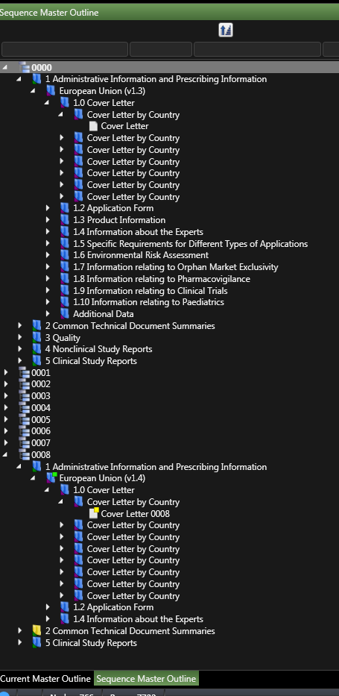

Slide 27
The Quantum Leap…
A change in perspective… and a change in attitude!
The future of regulatory compliance is the eCTD.
We need to ensure that we have the right tools and the right people to do the work in an ever-evolving environment.
It’s time to engage!

Slide 28


Slide 29
Thank You!
Questions?
Or maybe later…
henriette@mra-regulatory.com

